Slide 1
Customer Activation and Retention Project
By- Ankush chaudhari

Slide 2
Content:
Problem statement
Data analysis
Visualization
Conclusions

Slide 3
Problem statement:
E-commerce has become a vital part of our life in this day and age.
The popularity of the internet era has resulted in an increase in the number of online retail businesses. The key to keeping the top spot is data analysis.
While marketing the monitory benefits makes it simpler to recruit clients, maintaining their loyalty is a challenge.
In our case, retention equates to satisfaction right now.
The data acquired through surveys and other methods are carefully analyzed with the purpose of gaining user approval.
The more recommendations there are, the more universal the users' attitude is, which can be utilized to measure user satisfaction.

Slide 4
Data analysis and visualization:
We started with loading the dataset using python libraries and then identified all the variables along with the data types in each variable as well as null values and found that all the variables are of categorical in nature with datatypes either object or integer.
To view customer attitude we did an analysis of features and classes associated with those. We counted different classes associated with each feature.
Some observations are as follow:
Females between the age group 20 to 50 years are shopping more than other categories or age groups.
Most easy and convenient method of payment is a Credit/Debit card because offers on these help in attracting customers.
Customer support is highly important for online shoppers.
User loyalty is also influenced by monetary advantages and trust in the retailer.

Slide 5

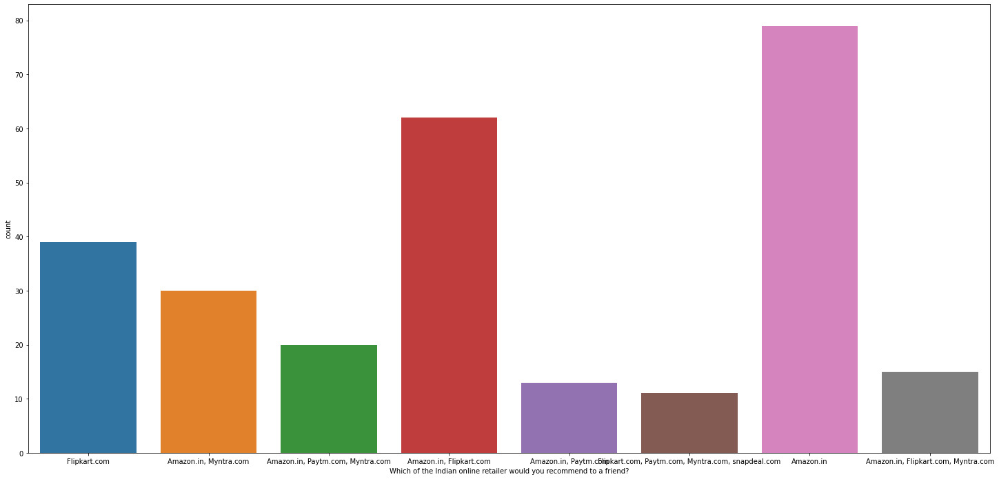
Bar chart of user recommendations:
Amazon is the most recommended online retailer by most customers.
Flipkart is the second one and Myntra holds third place.
There are only a few recommendations for Snapdeal and Paytm

Slide 6
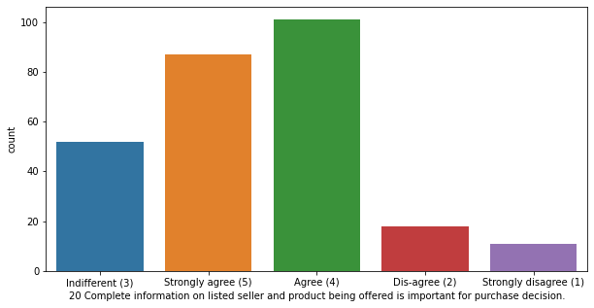
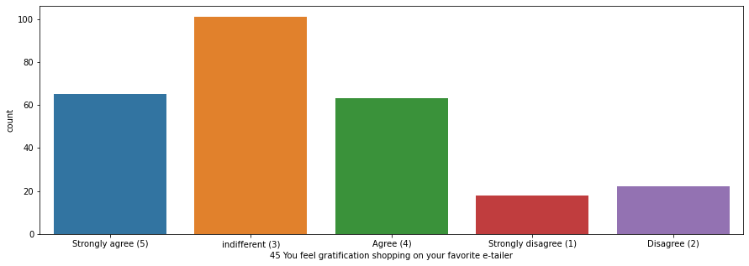
Count plot of factors concerning utilitarian and hedonic values:

Slide 7
It is very crucial for customers to be provided with all the information regarding the product
Happiness of customer is directly related to the offers provided by the retailer.
Almost half of the customers agree that gratification is achieved through shopping.

Slide 8
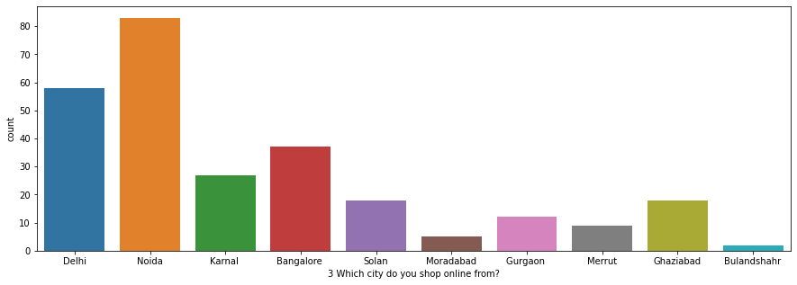
Most of the customers shopping online from Noida City, followed by Delhi, Bangalore, and Karnal
There are only a few customers from Bulandshahr and Moradabad who does online shopping

Slide 9
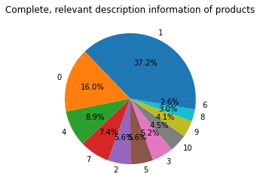
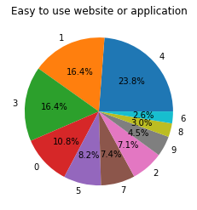
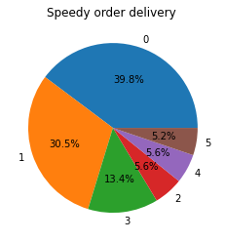
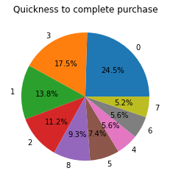
Why is amazon the most Popular choice of customers?
As we can see that customers prefer complete and relevant information of the product which helps them to explore many options and compare these products.
Easy to use website or application is another factor that plays an important role in online shopping. Also, retailers can get more attention to their products if the website is easy to use.
Most of the customers want their order to get shipped fastly and deliver as soon as possible.
Quickness to complete a purchase is directly proportional to easy to use website. If the website or application is easy to use, customers can easily order products in few minutes and go to checkout.

Slide 10
Conclusions:
The variables which the consumers strongly agree on effects their opinion are – trustworthiness of the retailer, monitory benefits supporting the idea of value for money, empathetic customer assistance, functioning of the website, and complete relevant information on products.
In the collected data, we see that ‘Amazon.in’ is the most popular online retailer with the greatest number of recommendations.
When analyzed, the reason for amazon's popularity is precisely performing well in the above-mentioned factors.
The mediocre services and functioning of a website often prompt consumer dissatisfaction.

